Slide 1
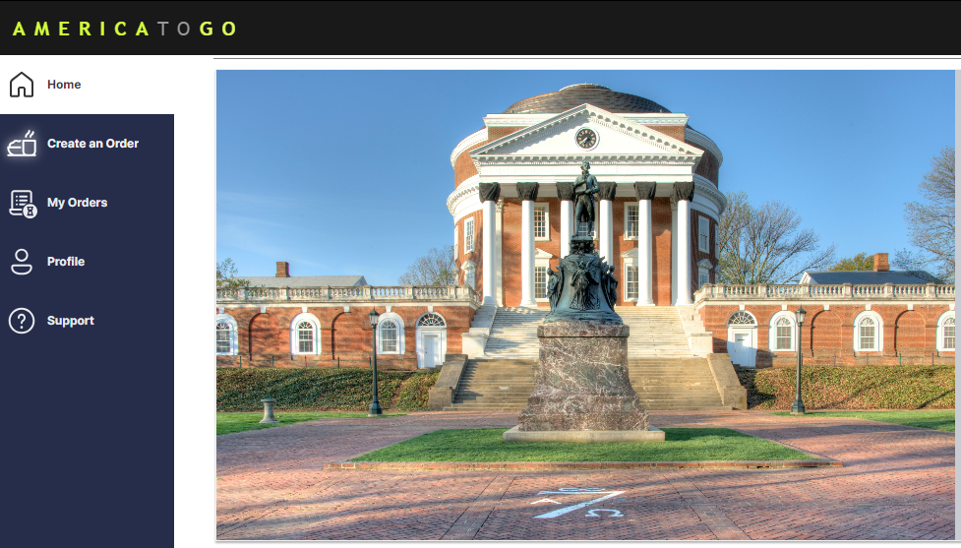
America to Go (ATG)
Main changes to expect with the new
punchout in UVA Marketplace on April 6th
Enhanced interface:
A ‘Home’ page with SWaM and Sustainability highlights
A ‘Support’ page with FAQs, How-Tos, and Customer Service information
‘Profile’ page with options for themes and user-specific information
Optimized ordering capabilities:
Ability to set and save specific ‘Deliver-To’ locations in the ATG ordering platform
Easier search functionality in ‘My Orders’, including the addition of an ‘Order Name’
Ability to request a change or cancellation in the ATG ordering platform, rather than having to call ATG Customer Service
Stay tuned for the post ‘go-live’ webinar on April 8th at 2 p.m.,
and check out these resources (ATG Video and Quick Reference Guides)
for more information!

